Slide 1


Modern Software Logistics
BUILD • SHIP • RUN • ANYWHERE

Slide 2

Complete Small Docker Project – Python Calculator App step by step.
✅ Create Project
✅ Write Python Calculator Code
✅ Create Dockerfile
✅ Build Docker Image
✅ Run Container
✅ Test
✅ Stop & Remove Container
✅ Optional: Push to Docker Hub

Slide 3
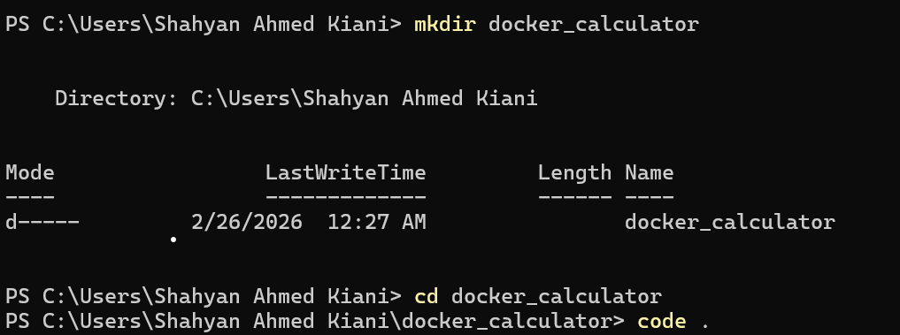
Complete Small Docker Project – Python Calculator App step by step.
Create Folder

Slide 4
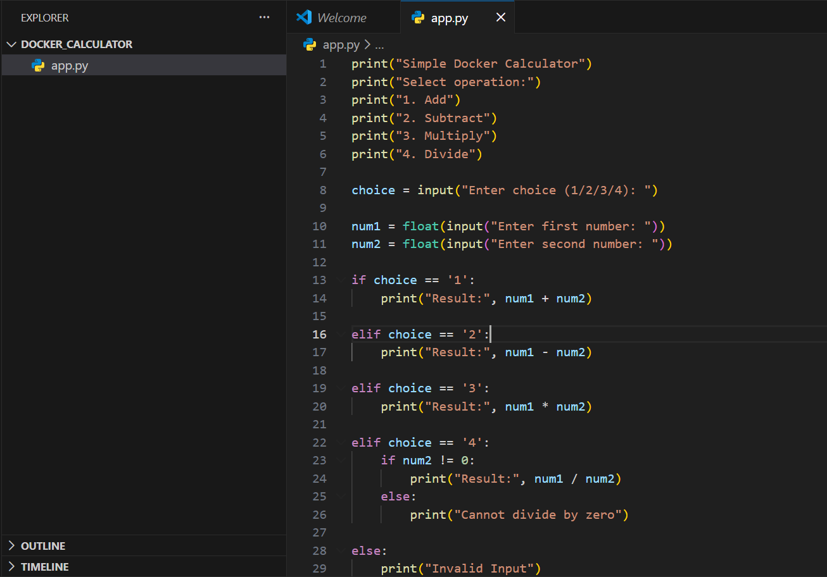
Complete Small Docker Project – Python Calculator App step by step.
CODE FILE

Slide 5
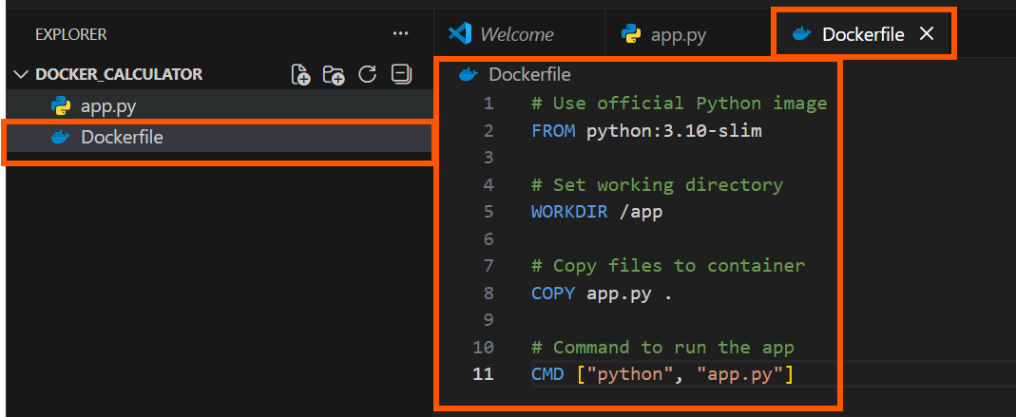
Complete Small Docker Project – Python Calculator App step by step.
Create Docker File

Slide 6
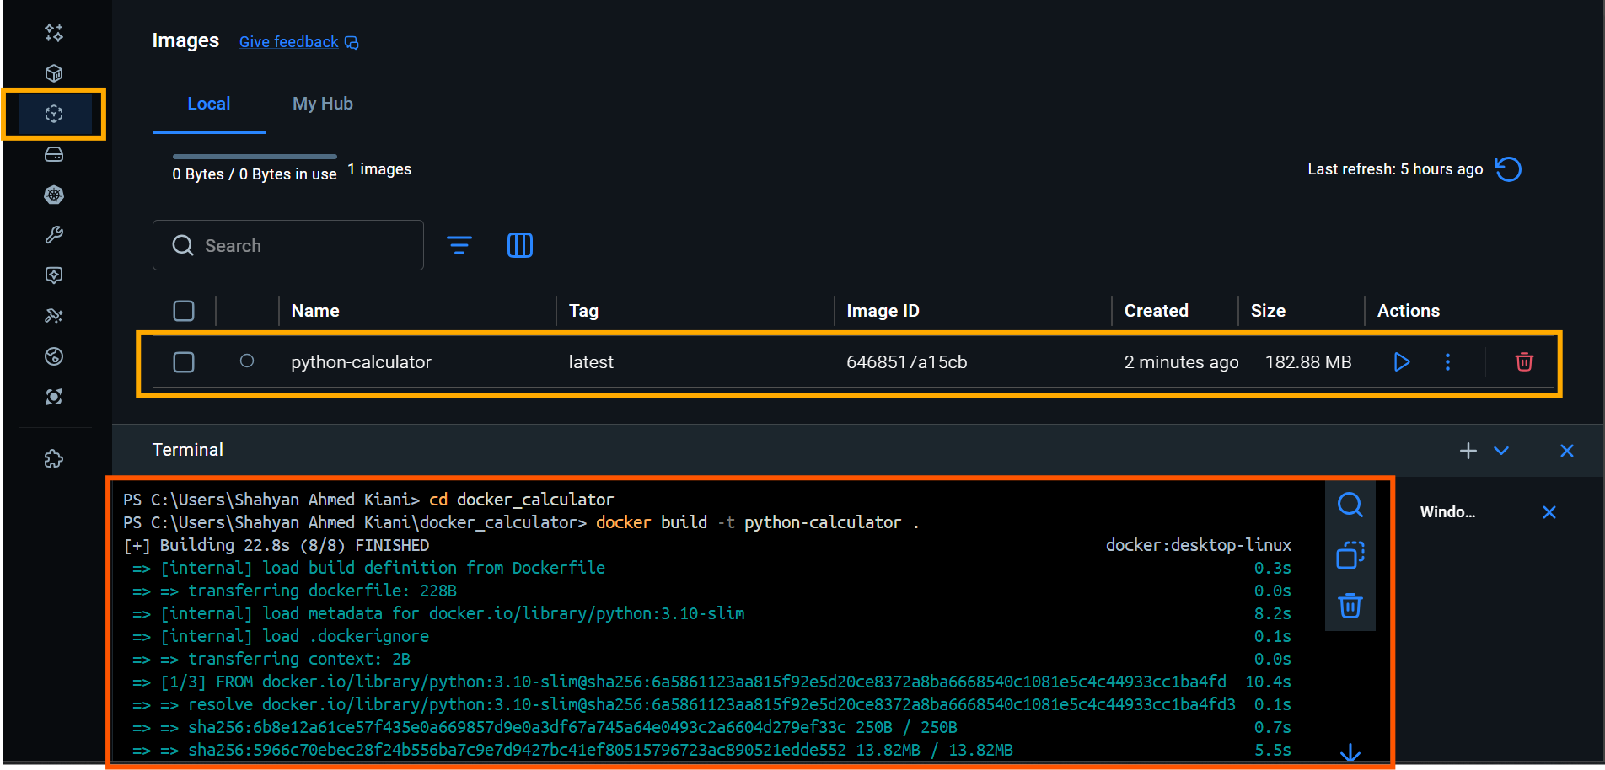
Complete Small Docker Project – Python Calculator App step by step.
Create Image : docker build -t python-calculator .

Slide 7
Complete Small Docker Project – Python Calculator App step by step.

Slide 8
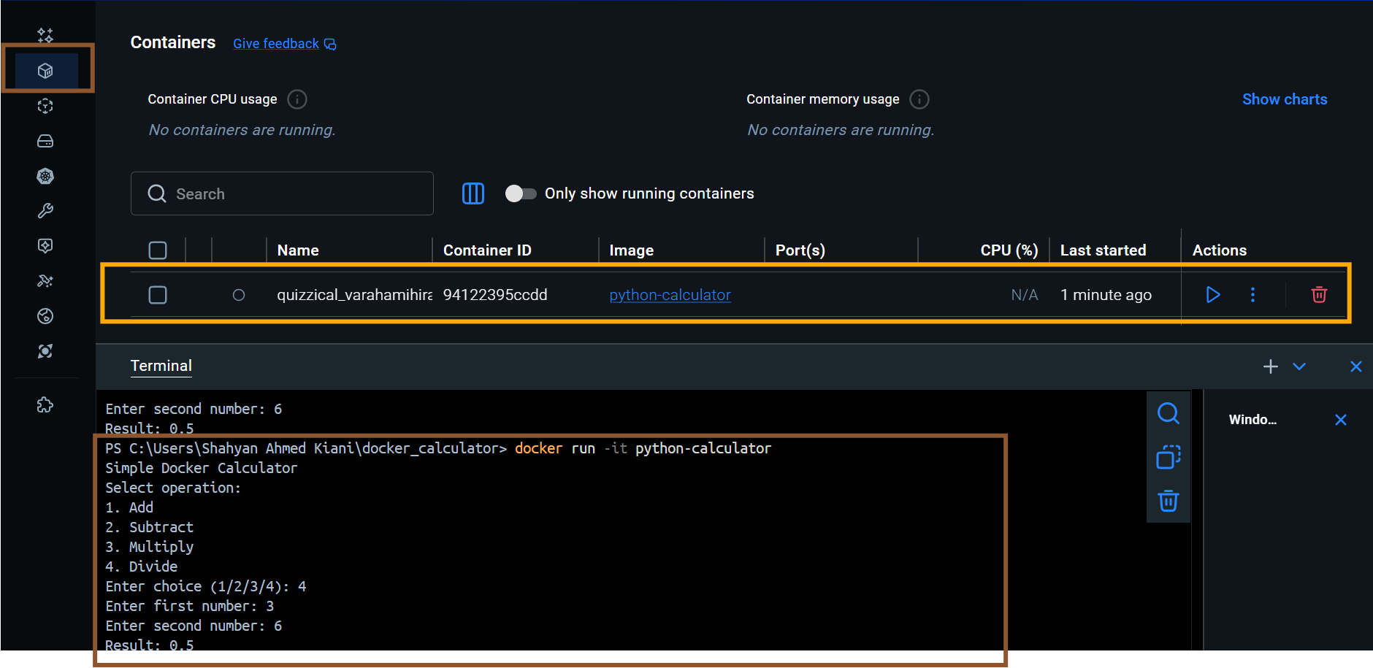
Complete Small Docker Project – Python Calculator App step by step.
Run Container

Slide 9
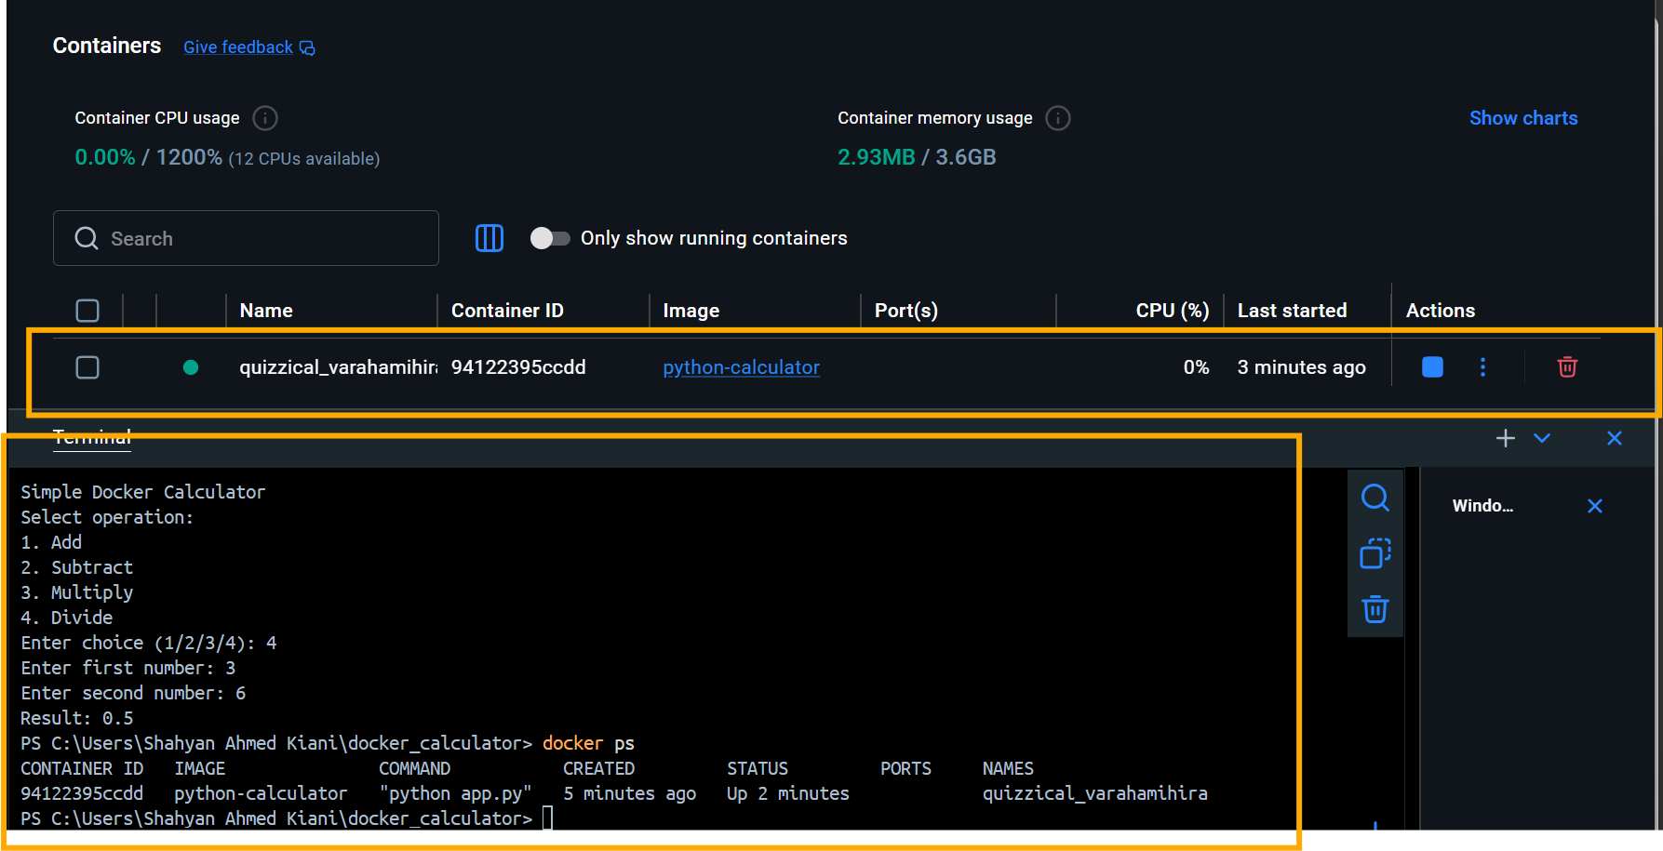
Complete Small Docker Project – Python Calculator App step by step.

Slide 10
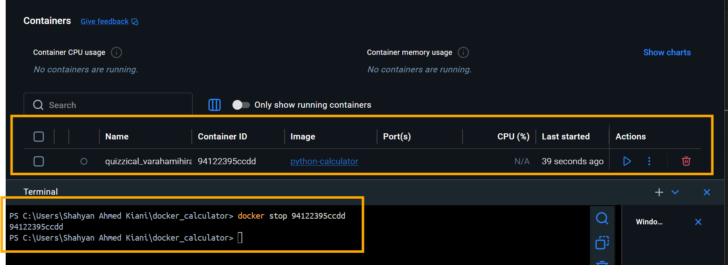
Complete Small Docker Project – Python Calculator App step by step.
STOP RUN CONTAINER BY ID

Slide 11
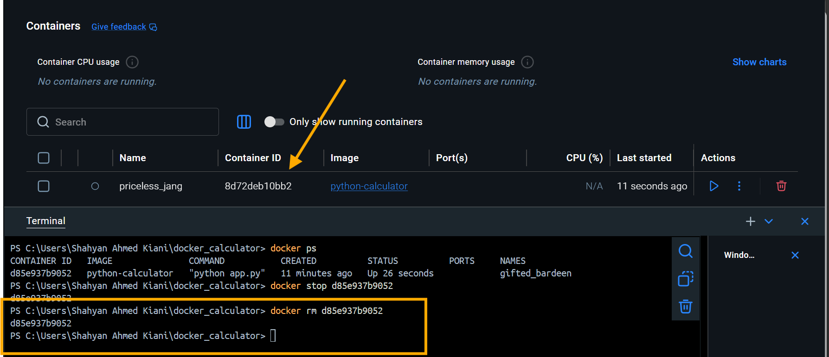
Complete Small Docker Project – Python Calculator App step by step.
REMOVE CONTAINER BY ID

Slide 12
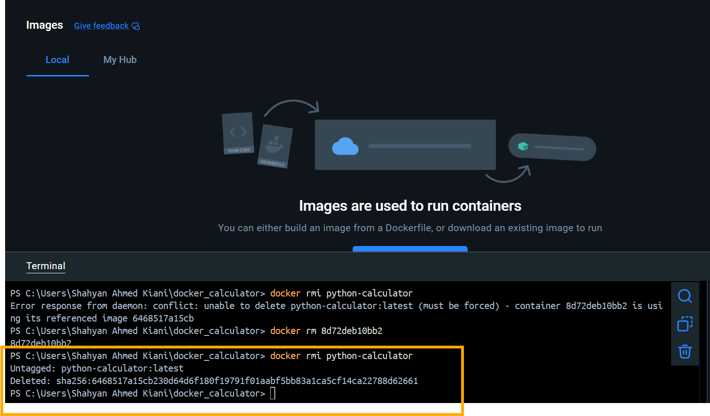
Complete Small Docker Project – Python Calculator App step by step.
REMOVE IMAGE

Slide 13
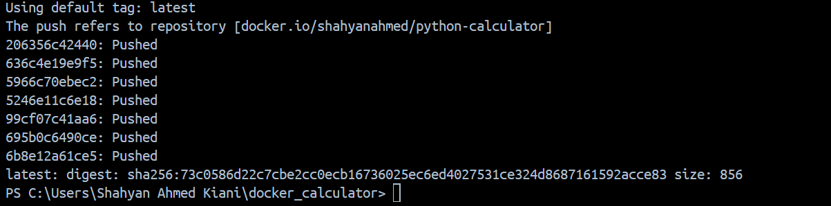
Complete Small Docker Project – Python Calculator App step by step.
PUSH TO DOCKER HUB
docker tag python-calculator shahyanahmed/python-calculator
docker push shahyanahmed/python-calculator

Slide 14
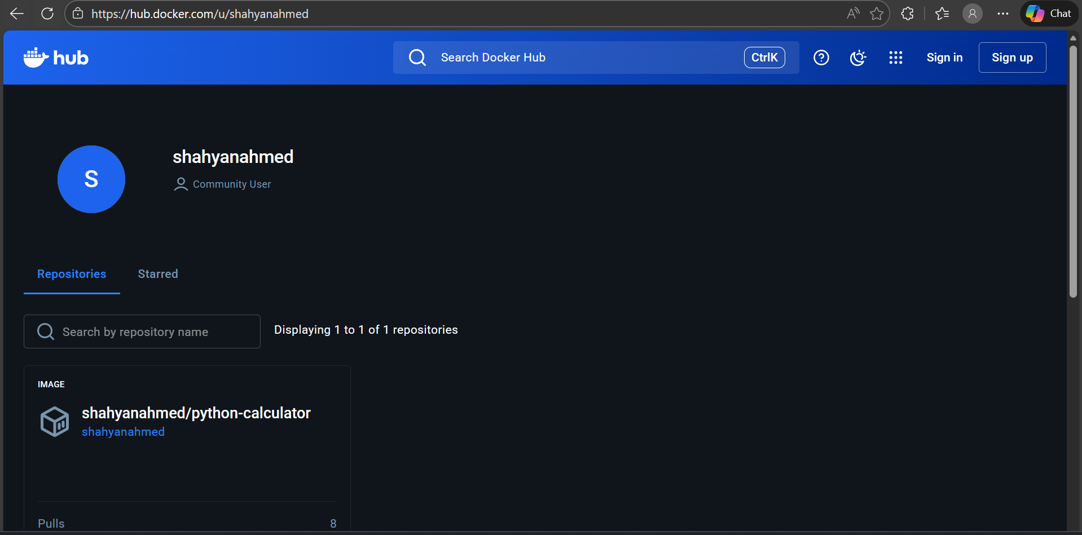
Complete Small Docker Project – Python Calculator App step by step.
PUSH TO DOCKER HUB

